Slide 1


Fınal Report
<Burak KArtal>

Slide 2

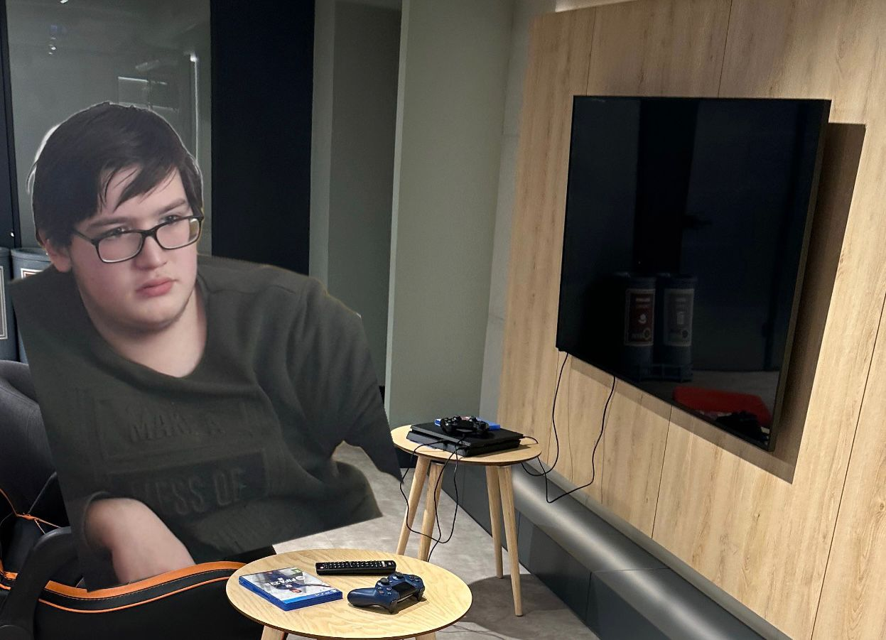
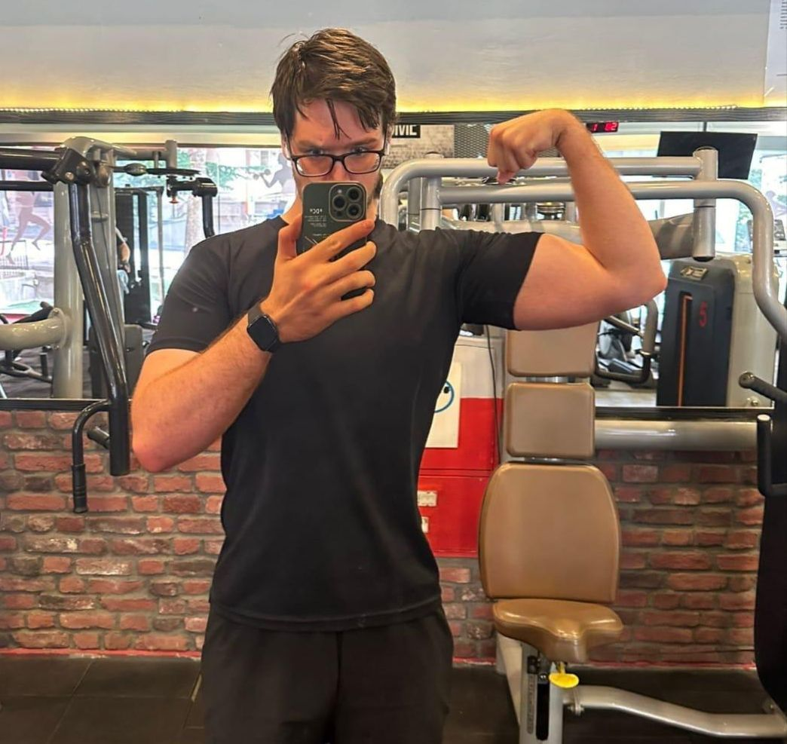
<Exploring the 'No Time for Gym' Dilemma>
A common complaint among people is, “I don’t have time to go to the gym.”
Leisure activities, such as watching TV, gaming, or other hobbies, are often cited as reasons for skipping fitnes routines.
Null Hypothesis : There is no significant correlation between the hours spent on watching TV and the number of days attending the gym.
Alternative Hypothesis : There is a significant correlation between the hours spent on watching Tv and the number of days attending the gym.

Slide 3


GYM Data Sources
Zepp Life and Mi Fitness Apps
Tracks weekly gym attendance (number of days).
Reliable for measuring fitness habits trough smart watch.
Time Frame
Data covers approximately one year (November 2023 to November 2024).
Weekly aggregation ensures consistency and aligns data from multiple sources.

Slide 4


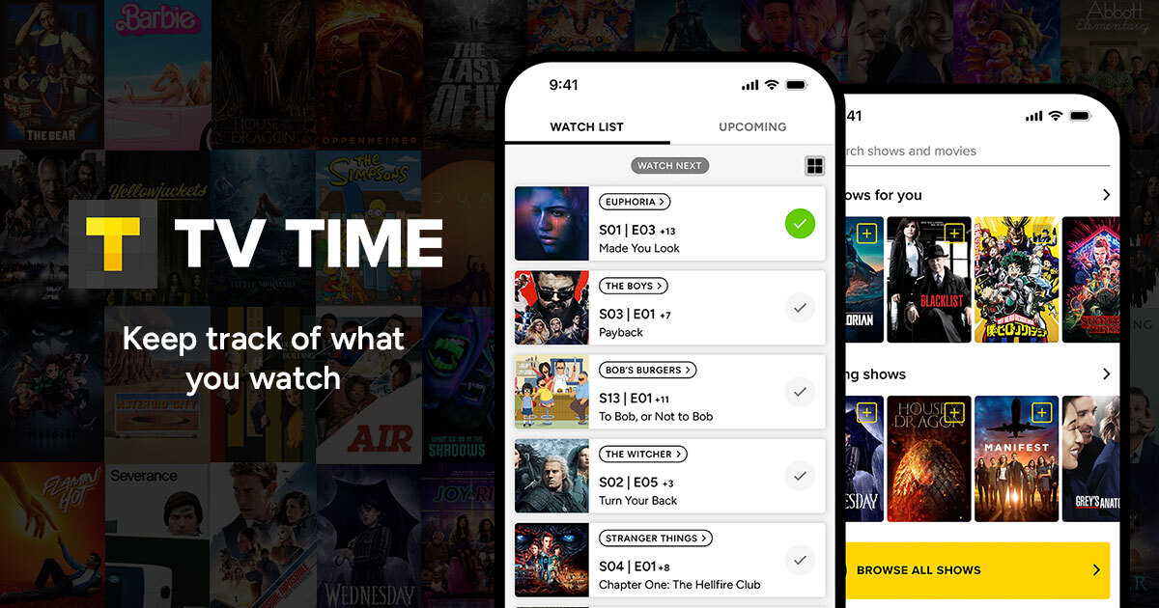
Hobbıe Data Source
TV Time App
Tracks time spent on leisure activities such as watching movies or TV shows.

Slide 5

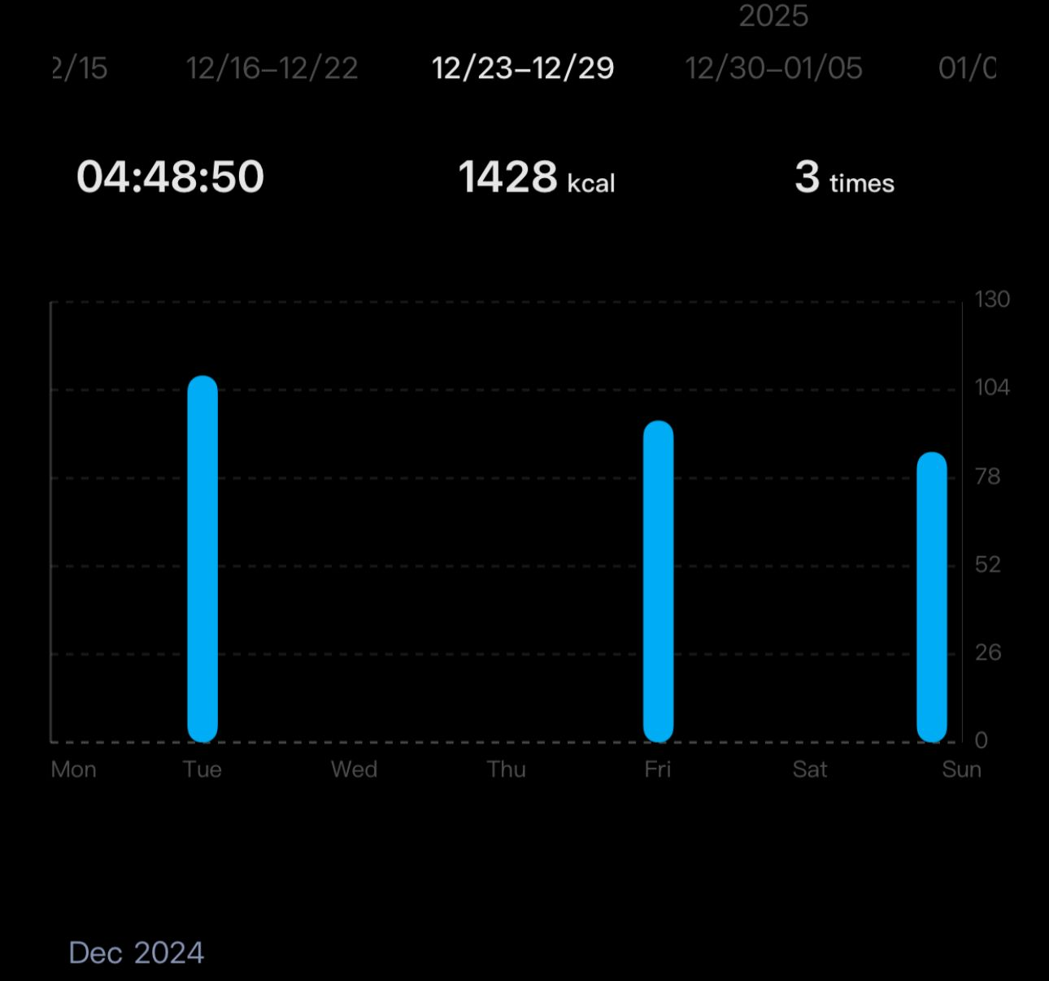
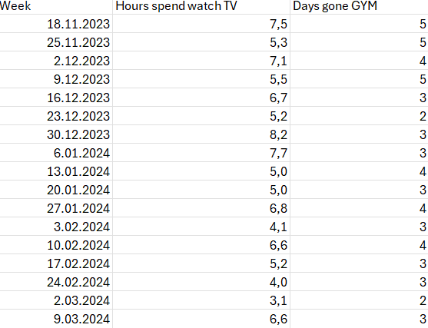
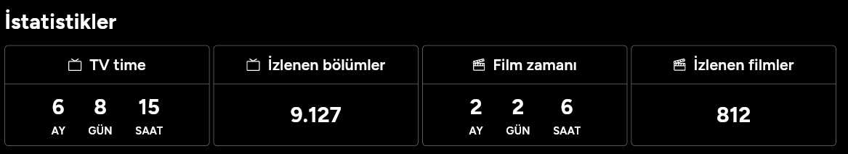
Method of Collection
Export and Integration:
Data was exported manually to excel from each app.
Weekly data points aggregated and aligned into a single dataset using Python and pandas.

Slide 6

Data Analysis: Techniques and Process
Techniques Used Correlation Analysis:
Used the Pearson correlation coefficient to measure the strength and direction of the relationship between hours spent on hobbies and gym attendance.
P-value calculated to test the significance of the correlation.
Visualization Tools:
Scatter Plot: Displays the relationship between hours spent on hobbies and gym days.
Heatmap: Shows the correlation matrix for a clear representation of the relationship strength.
Python Libraries:
Pandas: Data preprocessing and aggregation.
Seaborn & matplotlib: Creating visualizations for trends and patterns.

Slide 7
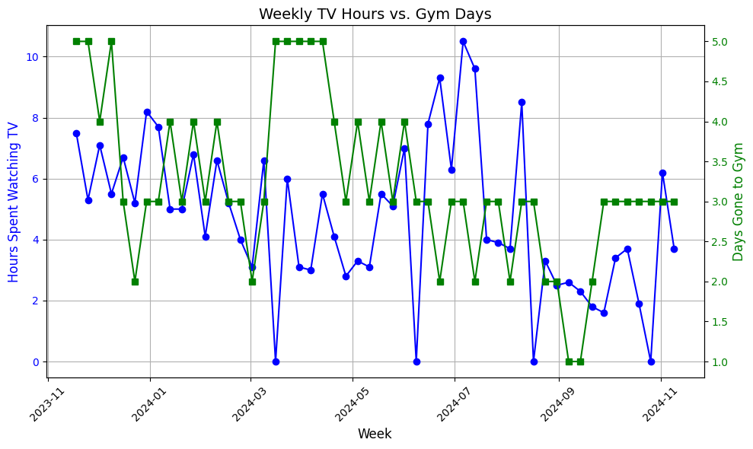
What I Learned About Myself
Commitment to Fitness:
Over the entire year, there wasn’t a single week where I skipped going to the gym. With a mean 3.3/week
This highlights my strong consistency and dedication to maintaining a fitness routine.
Flexibility in Hobbies:
In contrast, there were several weeks when I did not watch any movies or TV shows. With a mean 4.5 hour/week
This suggests that hobbies like watching TV are flexible and can easily be adjusted without impacting my routine or priorities.

Slide 8
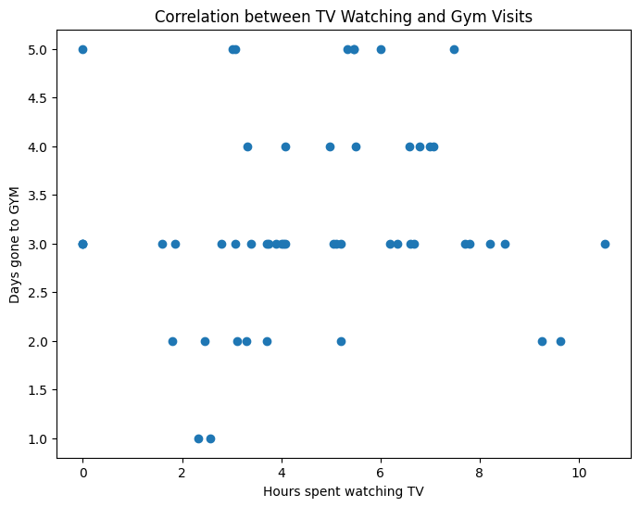
Trends Observed:
Gym attendance remains relatively consistent despite fluctuations in hobby hours.
Certain weeks with higher hobby activity did coincide with fewer gym visits, but the overall trend was not significant.

Slide 9
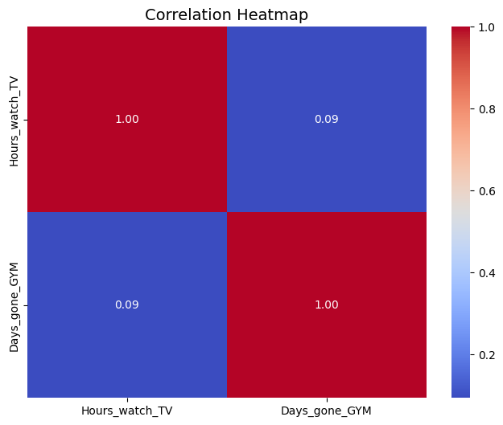
Correlation Analysis Results:
The Pearson Correlation Coefficient (r) measures the strength and direction of a linear relationship between two variables, ranging from -1 (perfect negative correlation) to +1 (perfect positive correlation), with 0 indicating no linear correlation.
The Pearson correlation coefficient (r) between hours spent on hobbies and days gone to the gym was 0.09.
A correlation coefficient of 0.09 indicates a very weak positive relationship between the variables.
The p-value tests the null hypothesis that there is no linear relationship between the variables, with a value less than 0.05 typically indicating strong evidence against the null hypothesis, suggesting a significant correlation.
The p-value was 0.5035, which is significantly greater than 0.05.

Slide 10
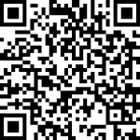
Fınally
Null Hypothesis:
There is no significant correlation between the hours spent on hobbies and the number of days attending the gym.
Thank you for your attention!
Please scan qr for giving feedback

Slide 11
Thank you for your time

